Slide 1
Video Production Process

Slide 2
Video Production process
Pre – Production
Query
Query Response
Meeting
Storyboard
Concept
Script
Recce
Shooting Schedule
Shooting

Slide 3
Video Production process
Production
Shooting

Slide 4
Video Production process
Post - Production
Final Video
First Cut
Editing
Final Cut

Slide 5

Video Production process
Pre – Production
Pre-production is the process of preparing all the
elements involved in a film. At this stage,
Finalizing preparations for production go into
effect.

Slide 6

Stages of Pre - Production
Client Query
In this client express their requirement or
uncertainty.

Slide 7

Query response
Doubts or questions raised by the clients are
answered.

Slide 8

Meeting schedule
Is fixed to discuss the various components of
films like concept, plan, budget etc.

Slide 9
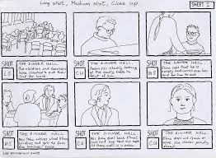
Storyboard
A rough, pictorial outline of different scenes,
camera angles, perspectives in a film or
interactive scenes.

Slide 10
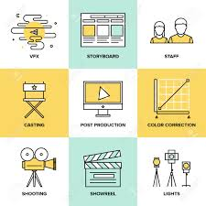
Concept
The concept is an idea used to tell your story by
combining all its characteristics or particulars.

Slide 11
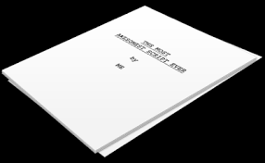
Script
A video script is a product of Concept, Structure,
Content, Style, and Format. Awareness of the
role of each will result in scripts that are
targeted to the audience and the goal of
the video.

Slide 12
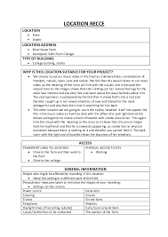
Recce
Preview and finalization of locations for shoot.

Slide 13
Shooting Schedule
A shooting schedule is a project plan of each
day's shooting for a film production. It is
Normally created and managed by the assistant
director, who reports to the production manager
managing the production schedule.

Slide 14
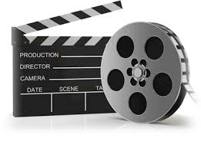
Production
Production refers to the tasks that are executed
During the filming or shooting. This includes
tasks such as setting up scenes, the capture of
raw footage, and usage of set designs.

Slide 15
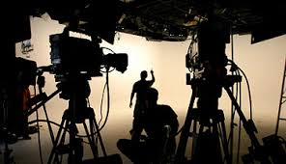
Shooting
Shooting are an essential aspect of a film where
angles, transitions and cuts are used to express
ideas and movements.

Slide 16
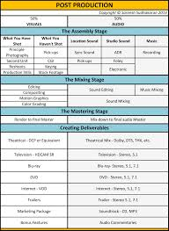
Post – Production
It is a term for all stages of production
occurring after the actual end of shooting
and/or recording the completed work.

Slide 17
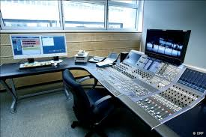
Stages of Post - Production
Editing
Is a process in which film is modified by adding
(music, graphics, voice over etc).

Slide 18
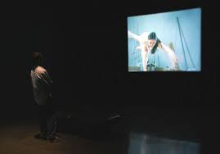
First video cut
Is a rough preview of film before finalizing.

Slide 19
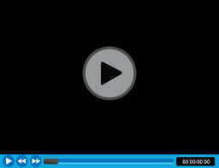
Final video cut
Is the process where editor works with the raw
footage, selecting shots and combining them
into sequence to create a finished motion film.

Slide 20

Feedback
An important part of the production process as
it speaks about the quality of work done.

